Slide 1
World of GRE
Name: Md. Foysal Mahmud.
Roll: 14CSE028.
Department of Computer Science & Engineering.

Slide 2
Introduction:
World of GRE, a android apps named represent the overall description about the
project. Already there are many Android apps on GRE. But most of them are in
English language and some Bangla language apps also present where those apps are
only provide vocabulary or less information about GRE.So in this apps showing the
details process of GRE examination and also provide famous books pdf download
link which is very popular for GRE. This apps provide a clear concept about GRE
without any confusion.

Slide 3
Apps Technology:
Platform:
Android Studio

Slide 4

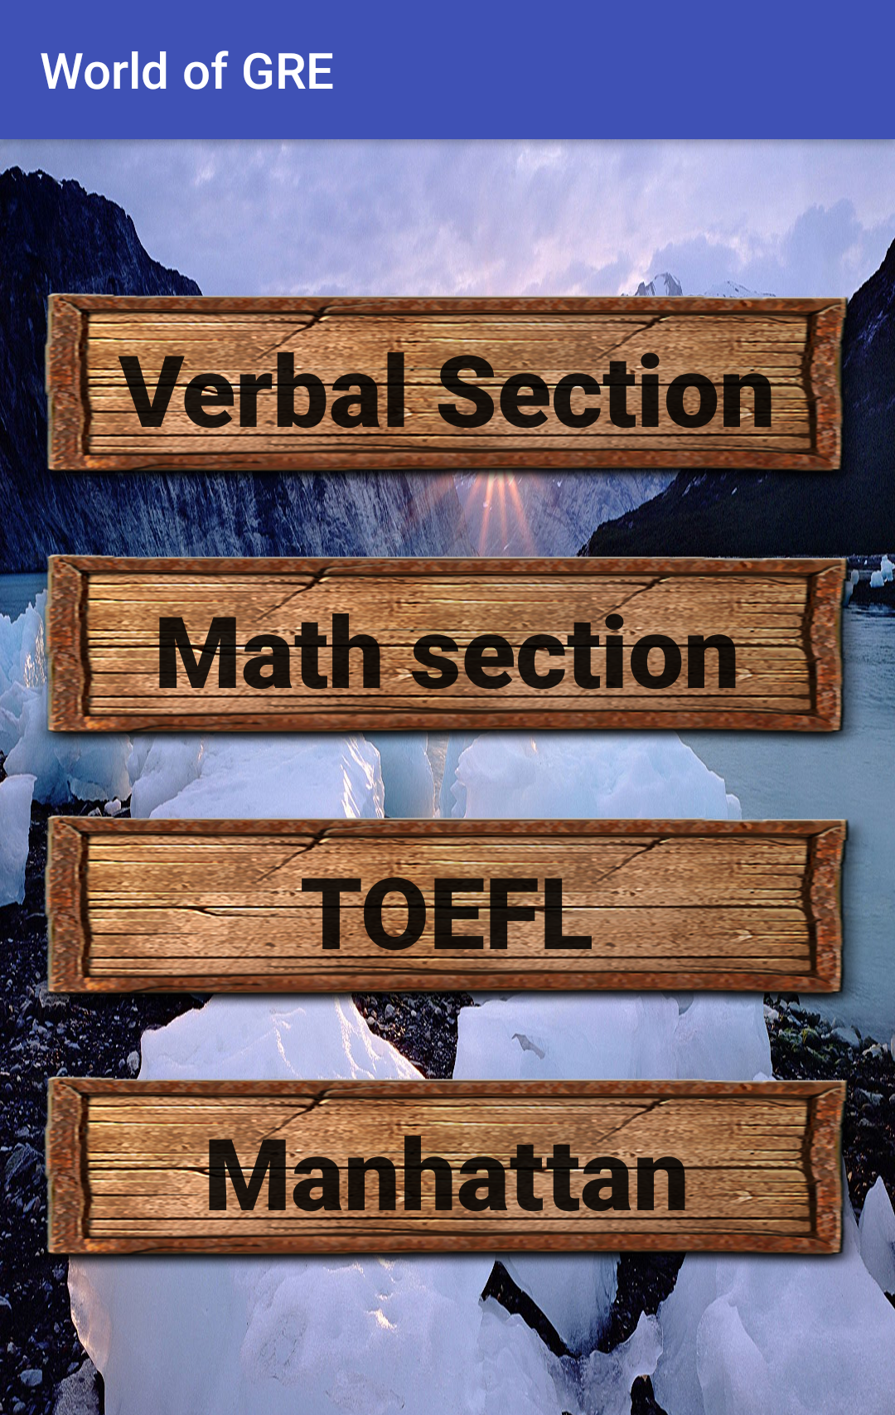
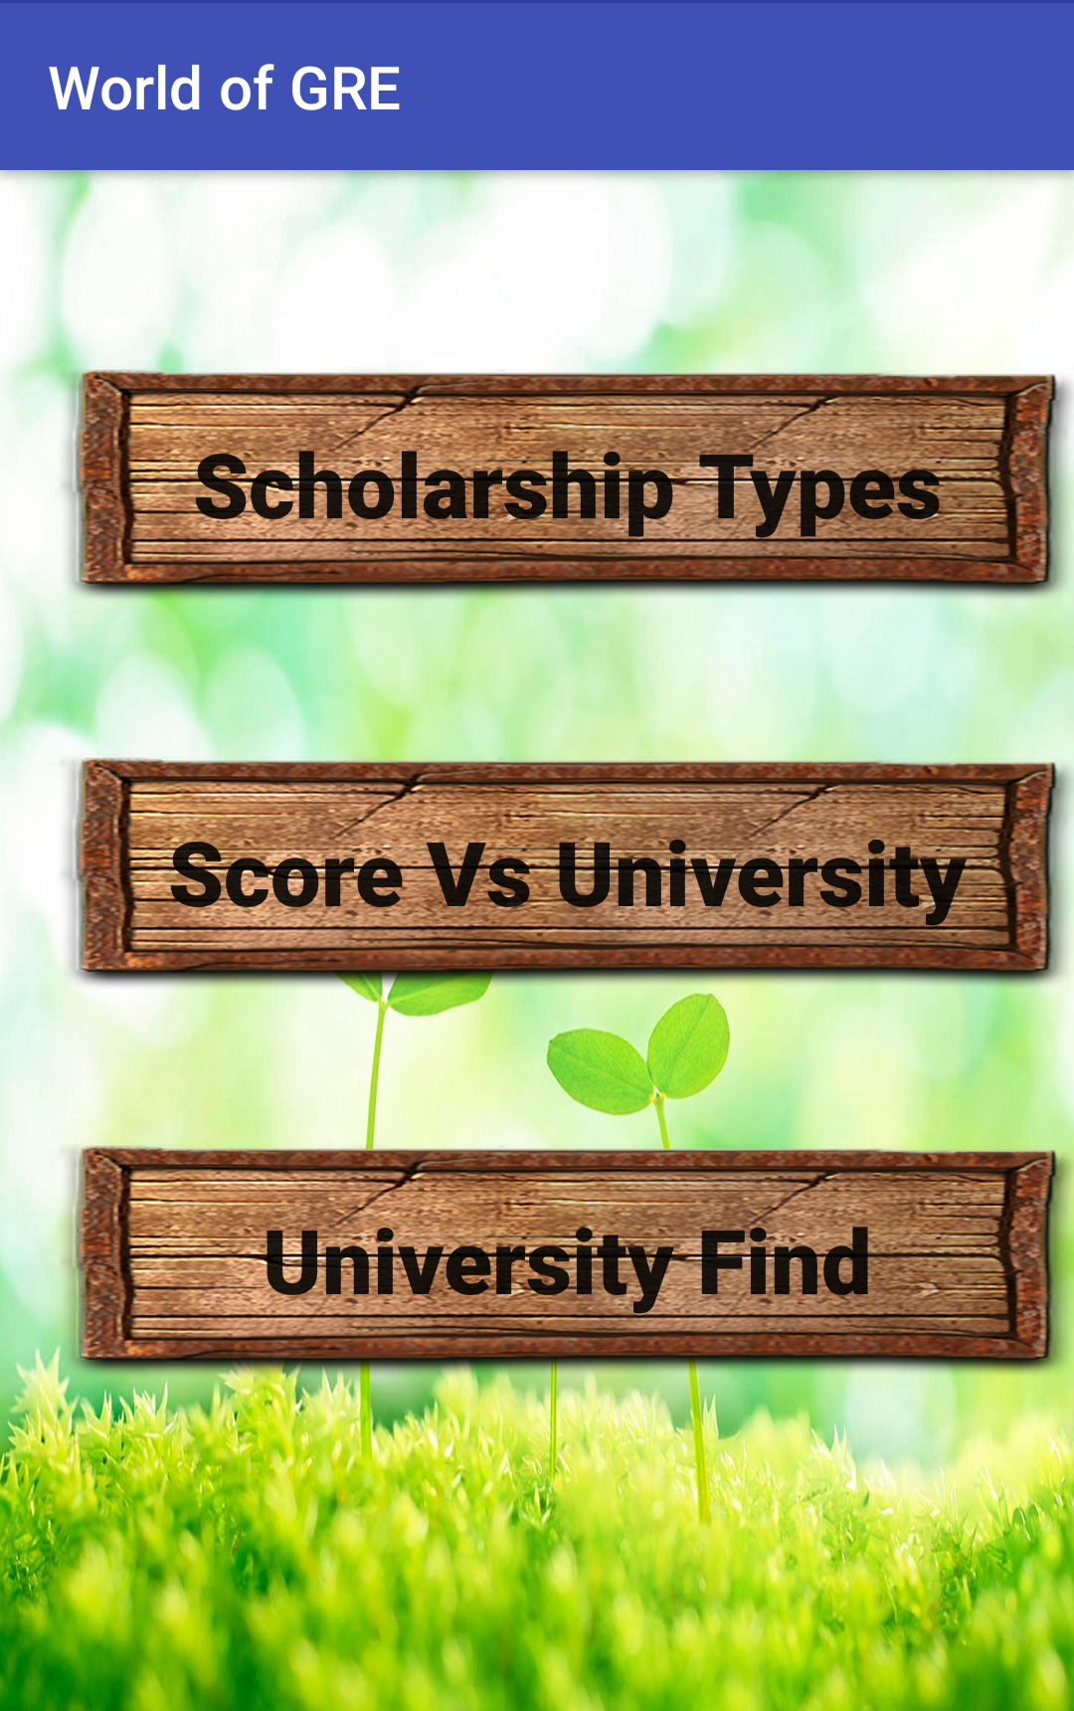
Apps Features:

Slide 5
Simulation of my Project:
Here is a video of My project simulation……….

Slide 6
Motivation:
For higher study in USA and Canada, GRE is must needed. For Bangladeshi student, they are very friendly with Bangla language rather than English. So, New candidate of GRE are found this apps very helpful.

Slide 7
Conclusion:
The purpose of this project is to increase user knowledge about GRE which is written in Bangla language for easy to understand.
My future purpose is to developed many useful and informative Android apps which really benefits for the users.

Slide 8


